Slide 1

7th Semester
Project Presentation
on
Missing Person Detection System
Presented by
Priyanshu Panda (Regd. No. : 20UG010312)
Sarin Kumar Sahu (Regd. No. : 20UG010328)
Akash Kumar Mohanty (Regd. No. : 20UG010334)
Under the guidance of
Dr. AVS Pavan Kumar
Professor, Department of CSE, GIET University
Gandhi Institute of Engineering and Technology University
24th November 2023

Slide 2

A Project Presentation on
“Missing Person Detection System”
Outline
Introduction
Project Overview
Technology Stack
System Design
Future Scope
Benefits and Impact
Challenges and Mitigations
Conclusion
Q&A

Slide 3
A Project Presentation on
“Missing Person Detection System”
Introduction
Every day, countless individuals, including children, youth, and the elderly, go missing in our society.
Despite the best efforts of law enforcement, the process of locating missing persons is often fraught with challenges.
The 'Missing Person Detection System.' A Revolutionary Web-Based Application Utilizing Machine Learning and Facial Recognition
Let's explore how this transformative project aims to revolutionize the way we approach and expedite missing person investigations

Slide 4
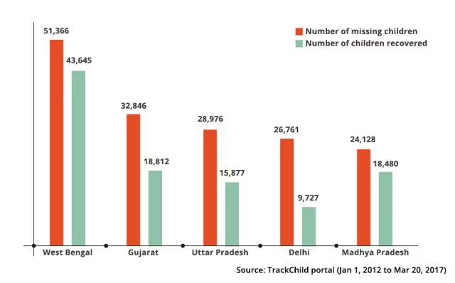
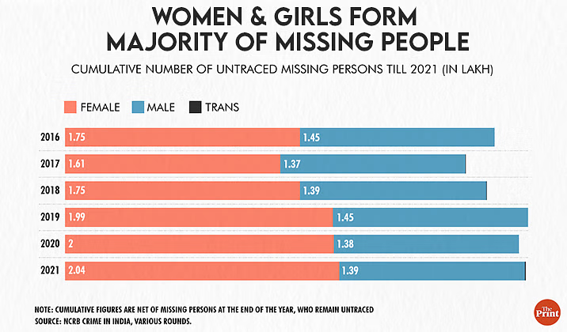
A Project Presentation on
“Missing Person Detection System”
Graphs of Missing children across India

Slide 5
A Project Presentation on
“Missing Person Detection System”
Project Overview
Objectives:
Streamline missing person search.
Reduce investigation times.
Provide timely notifications to authorities and family members.
System Features:
Advanced facial recognition algorithms.
User uploads images of missing persons.
Cross-references with a comprehensive database.
Generates alerts on finding a match.
User Roles:
Family members: Upload images and information.
Law enforcement: Efficiently manage and retrieve data through the database.

Slide 6
A Project Presentation on
“Missing Person Detection System”
Technology Stack
Languages Used:
Python
Django
HTML/CSS/Javascript/Bootstrap
Libraries:
OpenCV
face-recgonition
IDE:
VsCode

Slide 7
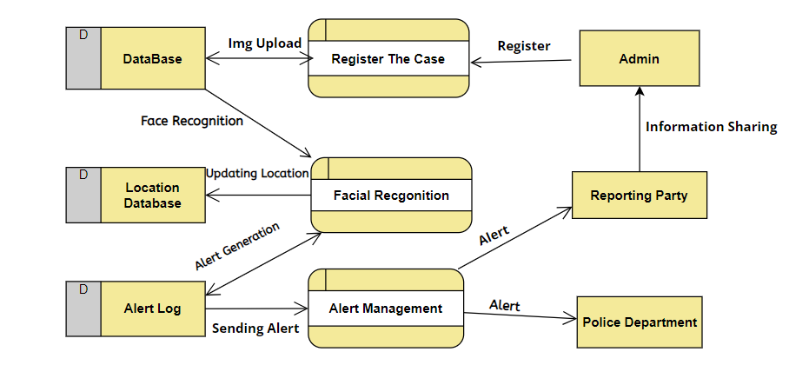
A Project Presentation on
“Missing Person Detection System”
System Design
Data Flow Diagram

Slide 8
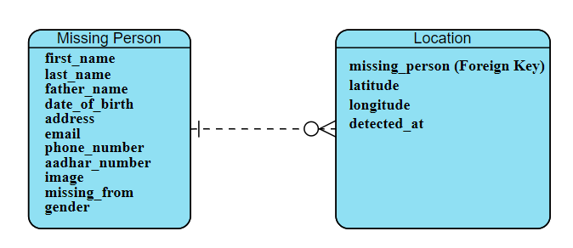
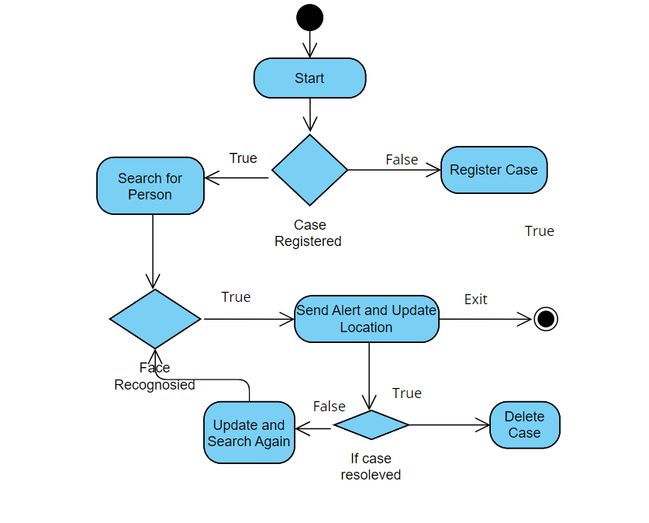
A Project Presentation on
“Missing Person Detection System”
System Design
ER Diagram
Activity Diagram

Slide 9
A Project Presentation on
“Missing Person Detection System”
Future Scope
Real-Time Video Analysis Integration.
Mobile Application Development.
Collaboration with Law Enforcement Agencies,
Integration with Social Media Platforms.
Integration with Public Services.
Implementing encryption protocols and data privacy.
Incorporating geolocation services and camera metadata.
Deploying the system on cloud services like AWS, Azure, or Google Cloud.

Slide 10
A Project Presentation on
“Missing Person Detection System”
Benefits and Impact
Rapid image uploads allow for quicker initiation of the search process.
OpenCV & face-recgonition ensures precise facial feature extraction, enhancing the accuracy of face encodings during matching.
Organized database ensures comparison during facial recognition
Automatic alert generation for authorities and concerned individuals.
Reduces the overall time and resources traditionally required for missing person investigations.
The project sets the stage for advancements in missing person detection, with potential applications extending beyond current boundaries.

Slide 11
A Project Presentation on
“Missing Person Detection System”
Challenges & Mitigations
Challanges
Accuracy of Facial Recognition.
Protecting the privacy of individuals.
Handling large volumes of image data and processing.
Collaborating with law enforcement agencies.
Mitigations
Advanced Facial Recognition Algorithms.
Secure Data Storage and Encryption.
Optimizing machine learning models to reduce computational complexity.
Standardized Data Exchange Protocols.

Slide 12
A Project Presentation on
“Missing Person Detection System”
Conclusion
Significance of the Missing Person Detection System: Revolutionizing the search for missing individuals.
Potential for Saving Lives: Timely identification and rescue of missing persons.
Contribution to Society: Enhancing public safety and reducing anxiety among families of missing persons.

Slide 13
A Project Presentation on
“Missing Person Detection System”
THANK YOU!!

